Slide 1
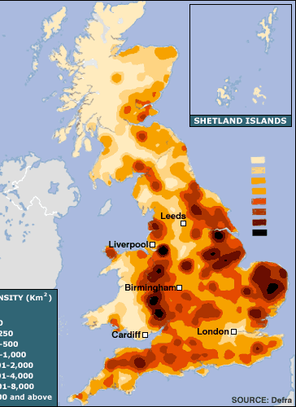
Implementation of permitting to pig and poultry in England
1333 IED Pig and Poultry farms in England
1098 poultry
235 pig
Permits reviewed between 2017 and 2019
Concern about permit thresholds driving inefficiency in production and unintended behaviours
Permits issued with improvement programmes to reduce ammonia emissions at Habitats sites
Notes:
The intensive pig and poultry sector was first brought into regulation in 2007. We now have 1327 intensive farming environmental permits – 1097 for poultry and 234 for pigs.
Numbers of permitted farms has steadily risen over the last 10 years from around 900 permits in 2008 - largely due to significant growth in the poultry sector particularly broiler farms / changes to welfare in laying hens regulations
3% of pig farms and 10% of commercial pig farms
6
ADAS did some work estimating permitting circa 83% of poultry production and 55% of pig production
Our aim is to improve the regulation and the compliance of the pig and poultry sector and to build on this to develop innovative proposals for bringing the dairy and beef sector into regulation
Permits issued with improvement programmes.

Slide 2
