Slide 1

IMPEL
DEPOSITION OF NITROGIN
THE SILENT DEGRADATION OF BIODIVERSITY
Paul Verreijt (OMWB)
IMPEL - Murcia
03-05-2023
Tilburg, the Netherlands

Slide 2
(Again) emphasizing urgency
Large number of studies identify increased nitrogen inputs, particularly via atmospheric nitrogen deposition, as a major culprit of biodiversity loss in both terrestrial and aquatic ecosystems worldwide
Increased nitrogen deposition may affect plant sensitivity to factors such as drought , frost, and pathogens etc (Bobbink et al., 1998).
Drought means less chalk in soil (a base) → high deposition of nitrogen leads to more acidification (nitrification process), cumulative effect

Slide 4
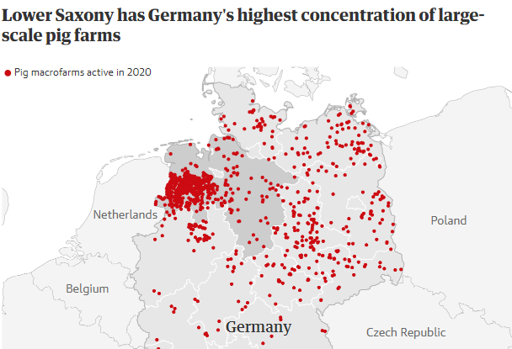

Slide 5
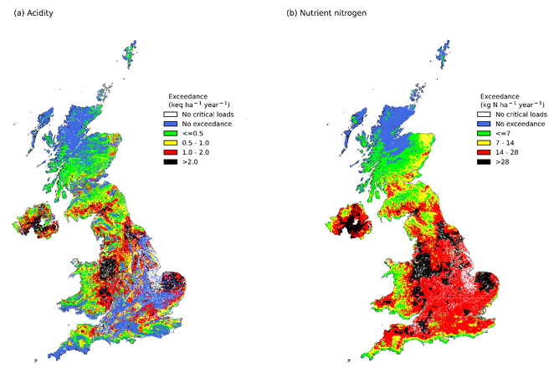
The area of N-sensitive habitats UK with exceedance of nutrient N critical loads decreased from 74.4% (69,781 km2) in 2010, to 67.7% (63,470 km2) in 2019.

Slide 6
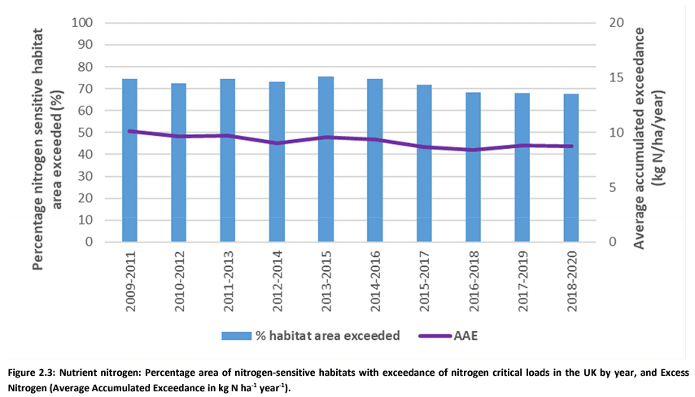

Slide 7
Situation Netherlands
Complete hold on permits, no more increase of deposition of N until natural habitats show recovery
bird chicks with broken legs & unborn eggs
heat stress trees combined with heavy metal (AI³⁺) poisoning due to drop in soil pH
leaching of important soil minerals
years of inaction led to political impasse
government has no solution yet, nitrogen ‘deniers’ on the rise

Slide 8
What is done so far?
Collected data on status exceedance eutrophication
CCE Status Report 2022 placed in IMPEL-map
Average mean of exceedance by nitrogen is 71 % within EU 27
Enough information (and conformation) for next steps
Survey ready and passed out
Analyses of CCE report

Slide 9
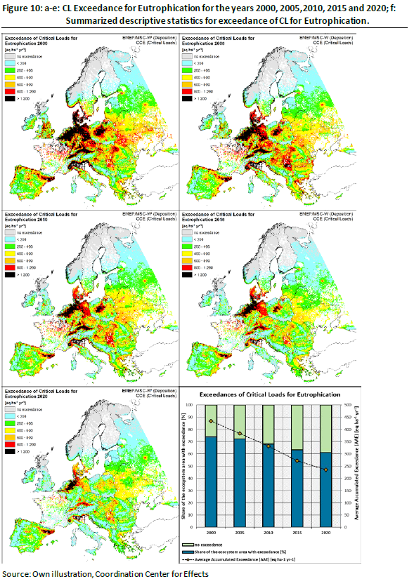
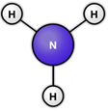
What are the results?
Eutrophication
throughout EU
Exceedance
Critical load N
Highest exceedances of CL
in the Po Valley in Italy, the Dutch-
German and German-Danish
border areas and in north-eastern Spain.

Slide 10
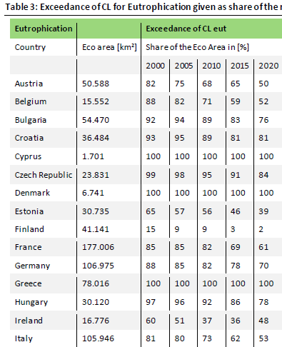

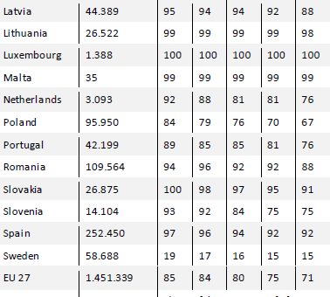
Results display deplorable state of nature preservation

Slide 11
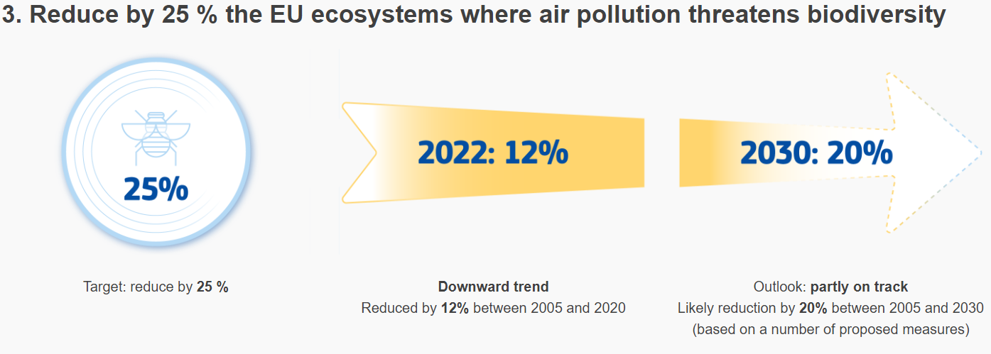
HD and zero pollution plan EU
improving air quality to reduce the number of premature deaths caused by air pollution by 55%
reducing by 25% the EU ecosystems where air pollution threatens biodiversity;
IED alone will not be enough to secure these goals! Art. 6 (3) HD is the key!

Slide 12
What’s next?
Survey shared to gain insight on:
  Status legislation, what is the CL used as threshold for nature sites under HD?
  Used tools for calculation of deposition
  Permits and enforcement
  Used strategy for selecting facilities
After this: recommendations on enforcing emission cuts based on exceedance CL and poor conservation of natural areas

Slide 13
What’s next?
After the survey: recommendations based on the results of available and supplied information will follow
As a reminder: Under Article 6 (3) of Habitats Directive (HD) it is crucial to determine whether a project, such as a livestock farm, can have significant effects on the conservation objectives of a Natura 2000 site and should be subject to an appropriate assessment, a process usually referred to as screening
due to their potential impacts on Natura 2000 sites all new or changing farm projects have to undergo the Article 6 (3) procedure!

Slide 14

Thank you!
Email: p.verreijt@omwb.nl
Website: www.impel.eu

